Slide 1




Luddy School of Informatics, Computing, and Engineering
Phase 4 - HOME CREDIT DEFAULT RISK - GROUP 11
Bindu Madhavi Dokala
(bdokala@iu.edu)
Jagadeesh Kovi
(jagakovi.iu.edu)
Sai Sathwik Reddy Varikoti
(svarikot@iu.edu)
Pranay Chowdary Namburi
(pnambur@iu.edu)
INDIANA UNIVERSITY BLOOMINGTON

Slide 2
Contents
Project Description and Workflow
Current phase workflow
EDA
Visual EDA Summary
Feature Engineering
Overview of Modeling Pipelines Implemented
Discussion and Results
Conclusion
Challenges

Slide 3
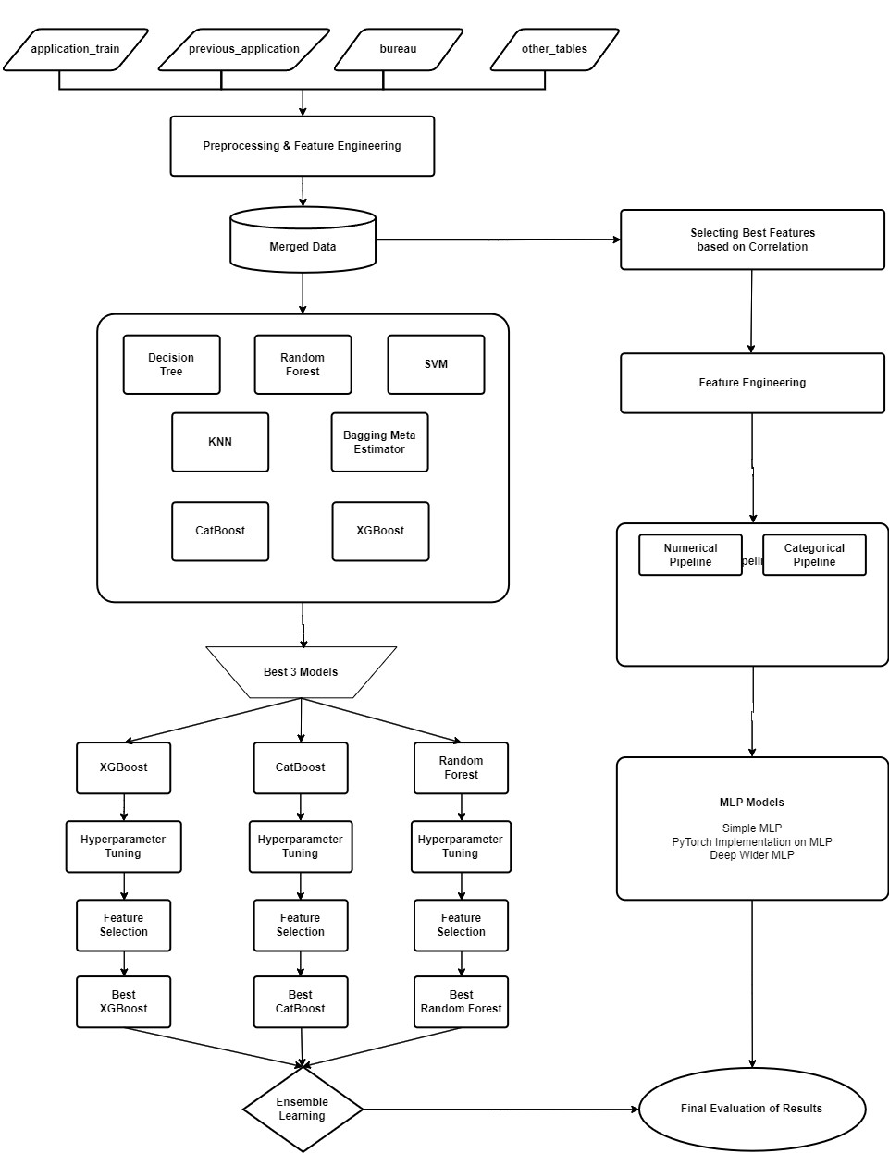
Project Description & Workflow
In the final phase of our project, we built upon the EDA & Visual EDA from phase 2 and feature engineering & selection from phase 3. Then we implemented Multilayer Perceptrons and built three different models.
We tried to fine-tune these models using hyperparameter optimization and feature selection to select the best performing model. Our efforts are directed towards aiding Home Credit in making informed lending decisions, reducing the frequency of unpaid loans, and expanding access to financial services for those with minimal banking history, ultimately contributing to economic inclusion

Slide 4
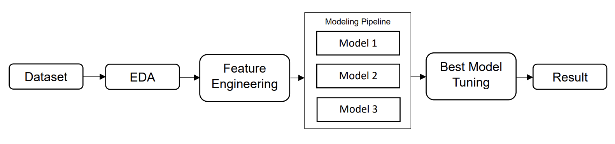
Current phase workflow

Slide 5
Exploratory Data Analysis.
Exploratory data analysis helped us identify the most important features of the data set through statistical graphics and other data visualization techniques. Here we considered:
The Datatypes and General Statistics of data (such as distribution of each feature using different kinds of graphs).
Missing values (percentage of the missing values in each dataset.)
Numerical and Categorical Data(Used different visualization techniques to find which type of data).
Correlation of the numerical data with the “Target” column(The result).

Slide 6
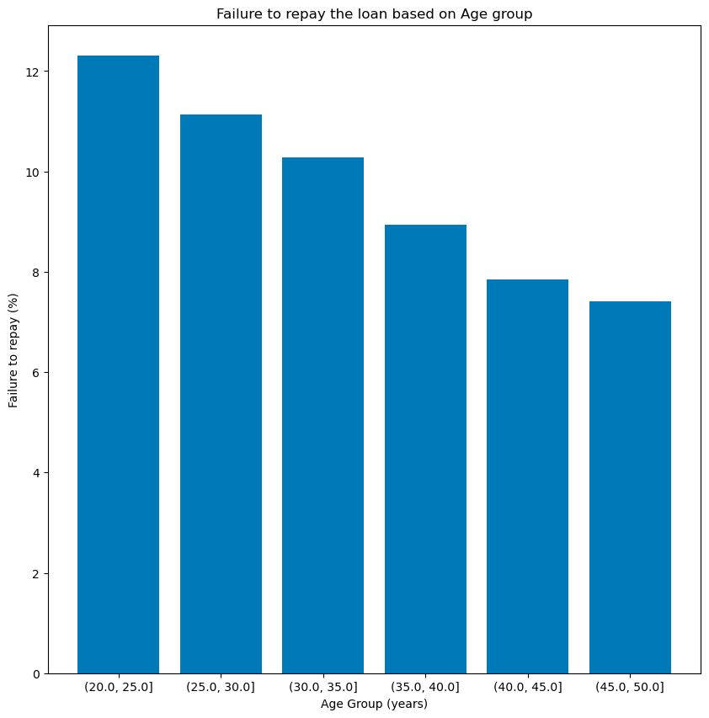
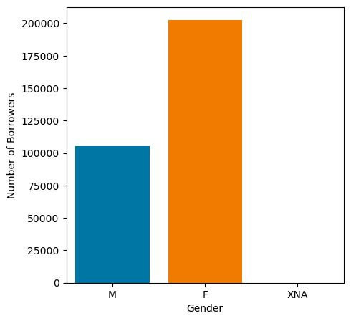
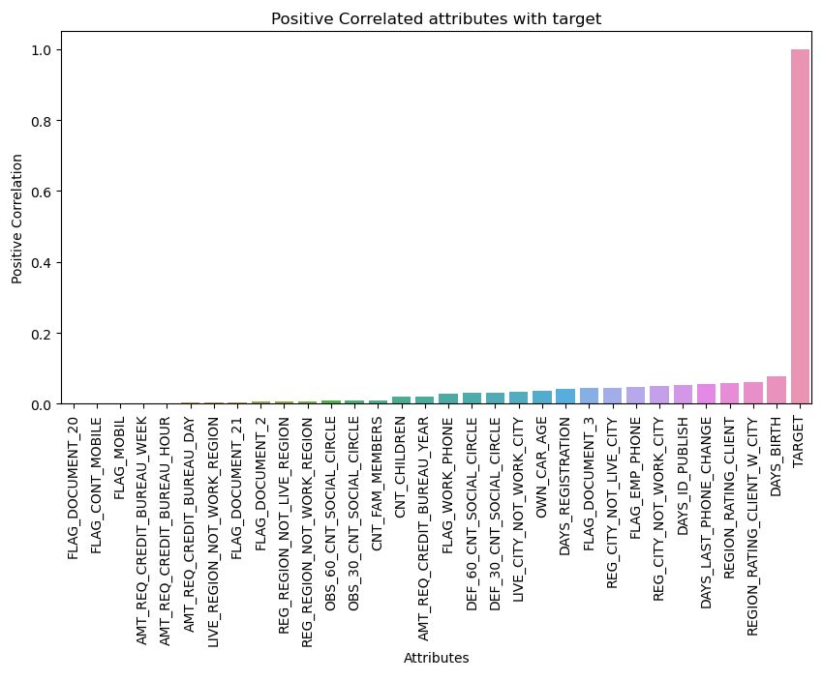
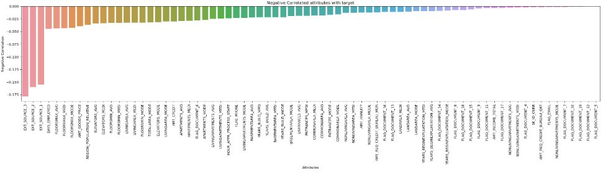
Visual Exploratory Data Analysis
VISUAL EXPLORATORY DATA ANALYSIS
Visual Exploratory data Analysis performed on Categorical values to understand their significance in data.
And analyzed relevant features with respect to target variable. Showing some visualizations on the right.
The graphs below depict the column features which are Positively correlated and Negatively correlated, based on target.
Age
Gender

Slide 7
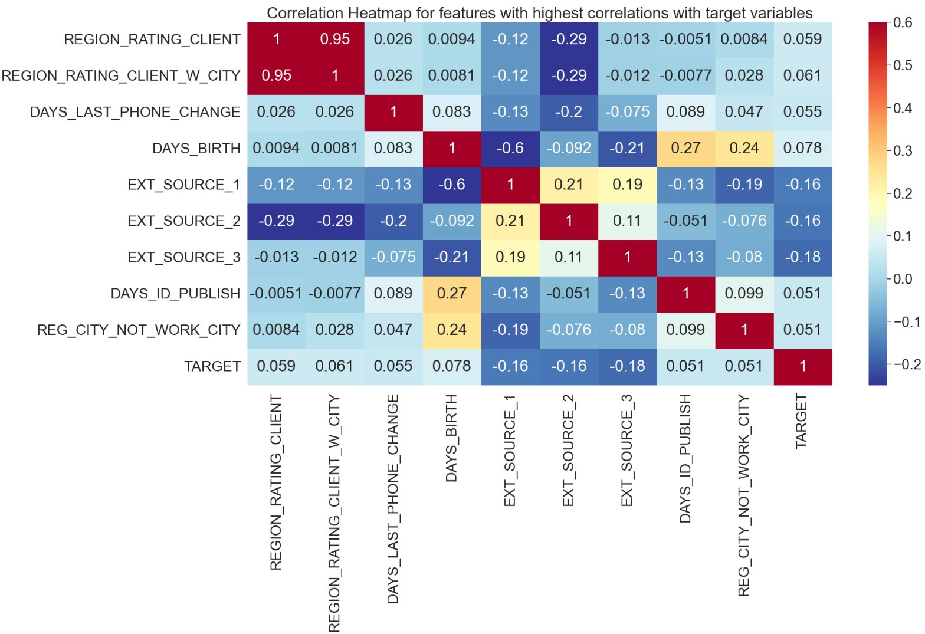
Visual Exploratory Data Analysis
Correlation heat map.

Slide 8
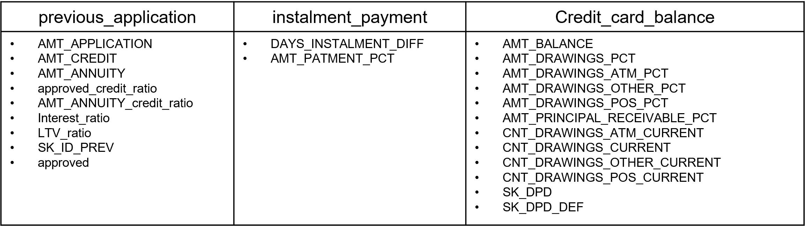
Feature Engineering between tables
Feature Engineering is done on “previous_application”, “instalment_payment”, and “Credit_card_balance” tables.
These following features have been engineered and selected.

Slide 9
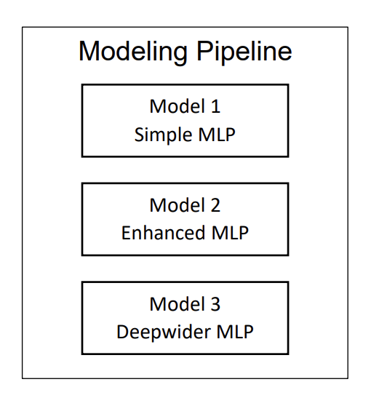
Overview of Modeling Pipelines explored
Simple MLP
Single linear transformation layer(sigmoid activation function)
Enhanced MLP
6 hidden layers (2⁹, 2⁸, 2⁷, 2⁶, 2⁵, 2⁴ – No. of neurons per layer)
Rectified linear unit (Relu) as activation function for hidden layers
Sigmoid activation function for output layers (2⁰ – No. of neurons per layer)
Deepwider MLP
Based on PyTorch deepwider architecture
8 hidden layers (2¹⁰, 2⁹, 2⁸, 2⁷, 2⁶, 2⁵, 2⁴, 2³ – No. of neurons per layer)
Same activation functions as of Enhanced MLP

Slide 10
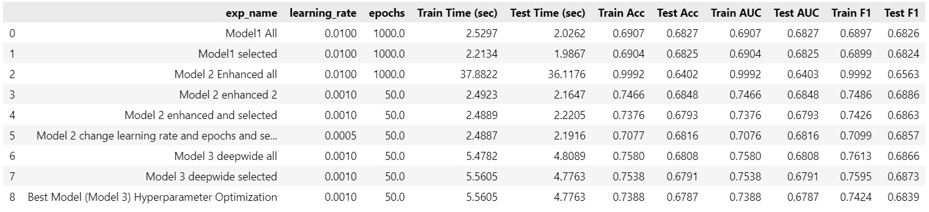
Discussion and Results

Slide 11

Conclusion
Ultimately, the goal of this project was to use previous data to forecast the probability that Home Credit clients would default. With customized features, we inferred that default risk might be reliably predicted by machine learning algorithms. In Phase 4, we experimented with Multi-Layer Perceptron (MLP) models and found that Enhanced MLP and Deepwide MLP showed strong performance, with test accuracies of about 0.68 and test F1 scores of 0.68.
Our project highlights how crucial feature engineering and hyperparameter tuning are to maximizing model performance. Further enhancements may involve experimenting with model architectures, regularization techniques, and hyperparameters. Additionally, feature selection may be improved; dataset sizes may be expanded. Experimenting with hyperparameter and advanced ensemble approaches may be employed to enhance lending judgments.

Slide 12
Challenges
Hyperparameter optimization in Neural Networks was challenging due to the complex, high-dimensional parameter space, hindering efficient exploration for optimal configurations.
It was difficult to work in the Google Colab and Mac environments since the code needed to be changed to work on different hardware.
Tensors, with their higher dimensionality and specialized operations, presented integration challenges alongside normal variables in computational tasks.
Even with strong processors, working with deep learning requires a lot of GPU resources; otherwise, it consumes a lot of CPU time.

Slide 13

Thank you

